Slide 1

Polymorphism
M1-D12
Participate! The more engagement the better! You are NEVER interrupting me!

Slide 2
Objectives
Polymorphism through Inheritance
Interfaces as a contract
Polymorphism through Interfaces

Slide 3
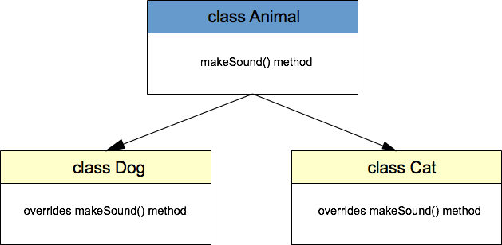
Polymorphism
In object-oriented programming, polymorphism allows us to perform a single action in different ways. However, the power of polymorphism is that it allows us to refer to these different ways generically.
Polymorphism via Inheritance
“is-a”
“is-a”

Slide 4
Bank Account Example (using inheritance)
Account, Savings, Checking, etc
Account
extends
extends
is-A
Savings
Checking

Slide 5
But what about objects that have similar behaviors but aren’t exactly the same?

Slide 6
Interfaces
Interfaces
Define what something can do or how it can be used, but not how it does it.
An interface is a contract that defines what methods a user of the interface can expect
What are the methods I can rely on being there for this object?
Cannot be instantiated
Multiple Interfaces are allowed for a single object

Slide 7
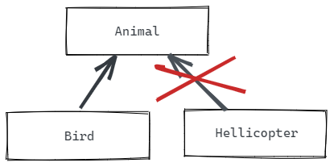
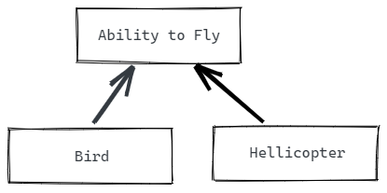
Object Context
An Object can have a relationship with another type in its hierarchy with an IS-A relationship.
A Bird IS-A Animal A Helicopter IS NOT A Animal
But we often want to group objects not by what they are, but what they can do, or by what abilities they have - a HAS-A relationship. This allows for grouping of unlike things with like abilities.
A Bird HAS-A ability to fly A Helicopter HAS-A ability to fly

Slide 8
Flying Example
Implement Flyable interface
Build classes that implements the Flyable interface (Drone, Glider, Bird, etc)
We have the ability to refer to each classes object implementations generically as Flyable List<Flyable>, etc
Can loop through a list and call implemented methods from interface

Slide 9
Revisiting Account example (Using Interfaces)
Implement the IAccount interface
Build the Savings, and Checking Account classes
Savings
implements
IAccount
Checking

Slide 10
What are the differences between an interface and a class?

Slide 11
We saw two different ways of implementing Accounts (interfaces vs inheritance). What advantages/disadvantages did you observe?

Slide 12
Java Interfaces
Interfaces contain only method signatures.
The accessor is optional since methods in an interface can only be public
Interfaces cannot be instantiated
Interfaces cannot have member variables
public interface Drivable {
void turn(String direction);
boolean accelerate();
boolean decelerate();
}

